Slide 1
How to Make Software More Robust
Changjian Zhang

Slide 2
Research Topics
FSE paper:
Focus on architecture level
Propose a behavioral notion of system robustness based on LTS
Plan: How to make a system more robust by transforming the corresponding LTS?
Related work: Model update/repair against CTL properties.
This independent study:
Focus on implementation level
Investigated: How to make a program more robust by transforming the implementation

Slide 3
What does “robust” mean?
Design by contract
Failure oblivious computing
Mutational Robustness?

Slide 4
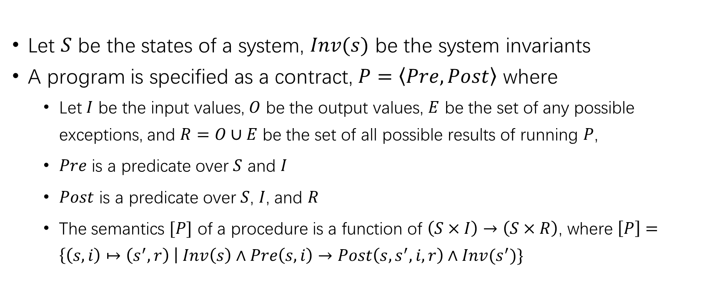
Design by contract
Pre Post
Input i
Procedure P
Output o
Let $S$ be the states of a system, $Inv(s)$ be the system invariants
A program is specified as a contract, $P=\left\langle Pre,Post\right\rangle$ where
Let $I$ be the input values, $O$ be the output values, $E$ be the set of any possible exceptions, and $R=O∪E$ be the set of all possible results of running $P$,
$Pre$ is a predicate over $S$ and $I$
$Post$ is a predicate over $S$, $I$, and $R$
The semantics $[P]$ of a procedure is a function of $\left(S×I\right)→\left(S×R\right)$, where $\left[P\right]=\left\{\left(s,i\right)↦\left(s^{′},r\right) \right| Inv\left(s\right)∧Pre\left(s,i\right)→Post\left(s,s^{′},i,r\right)∧Inv(s^{′})\}$
Exception e
Meyer, B. (n.d.). Applying Design by contract.

Slide 5
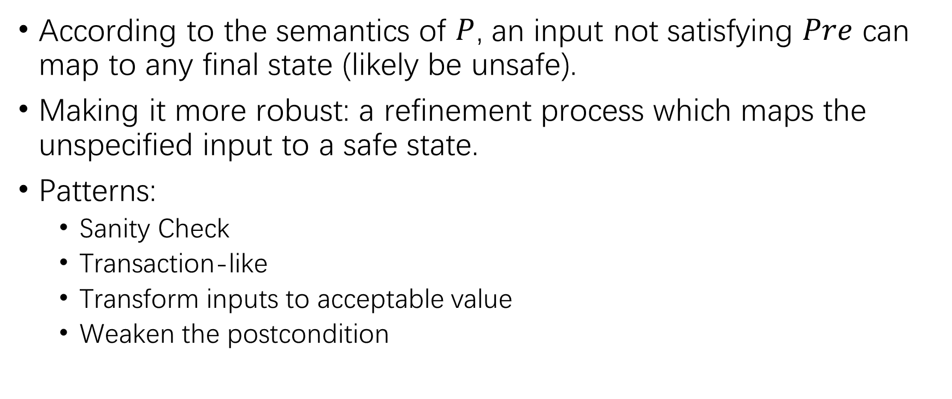
Transformation Patterns
According to the semantics of $P$, an input not satisfying $Pre$ can map to any final state (likely be unsafe).
Making it more robust: a refinement process which maps the unspecified input to a safe state.
Patterns:
Sanity Check
Transaction-like
Transform inputs to acceptable value
Weaken the postcondition

Slide 6
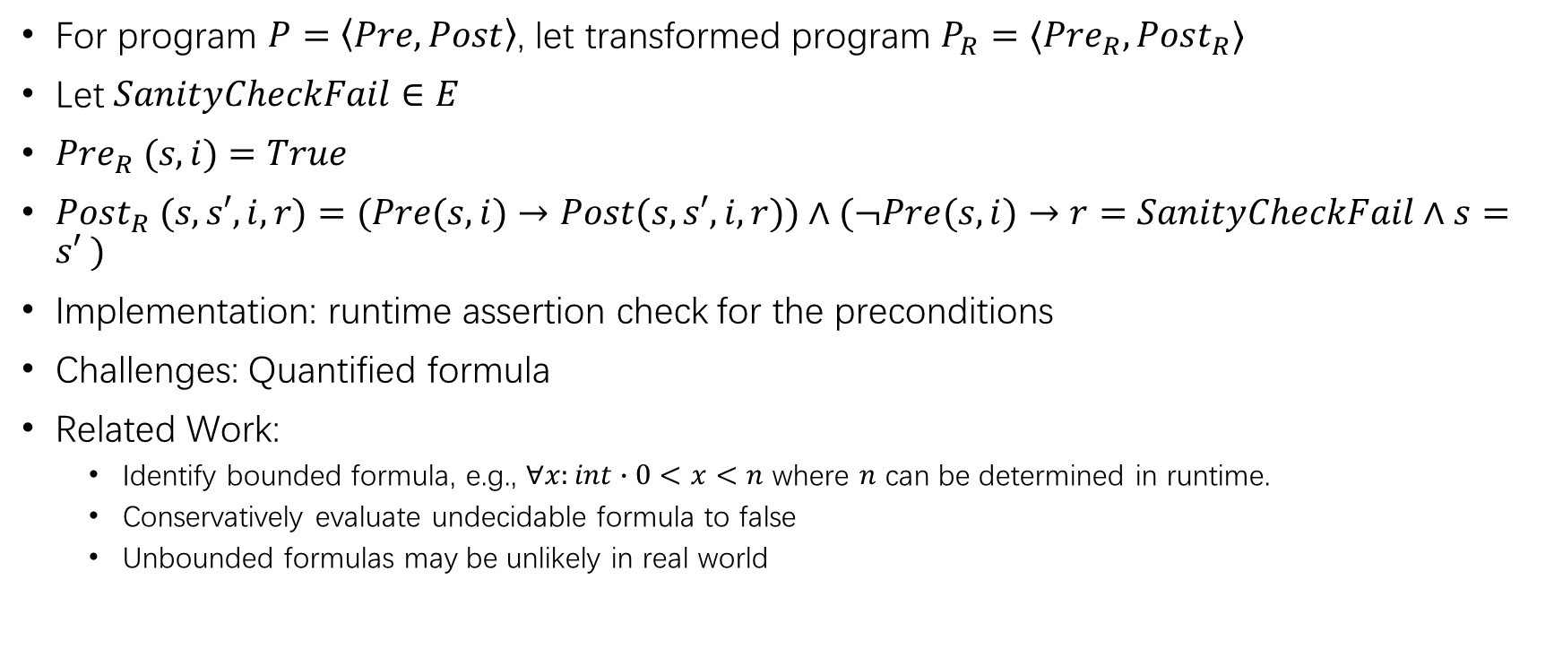
Sanity Check
For program $P=\left\langle Pre,Post\right\rangle$, let transformed program $P_{R}=⟨Pre_{R},Post_{R}⟩$
Let $SanityCheckFail∈E$
$Pre_{R} (s,i)=True$
$Post_{R} (s,s′,i,r)=(Pre(s,i)→Post(s,s′,i,r))∧(¬Pre(s,i)→r=SanityCheckFail∧s=s′ )$
Implementation: runtime assertion check for the preconditions
Challenges: Quantified formula
Related Work:
Identify bounded formula, e.g., $∀x:int∙0<x<n$ where $n$ can be determined in runtime.
Conservatively evaluate undecidable formula to false
Unbounded formulas may be unlikely in real world
Cheon, Y., & Leavens, G. T. (2002). A Runtime Assertion Checker for the Java Modeling Language (JML). Computer Science Technical Reports, 259.
Chalin, P., Kiniry, J. R., Leavens, G. T., & Poll, E. (2006). Beyond assertions: Advanced specification and verification with JML and ESC/Java2. Lecture Notes in Computer Science (Including Subseries Lecture Notes in Artificial Intelligence and Lecture Notes in Bioinformatics), 4111 LNCS, 342–363. https://doi.org/10.1007/11804192_16

Slide 7
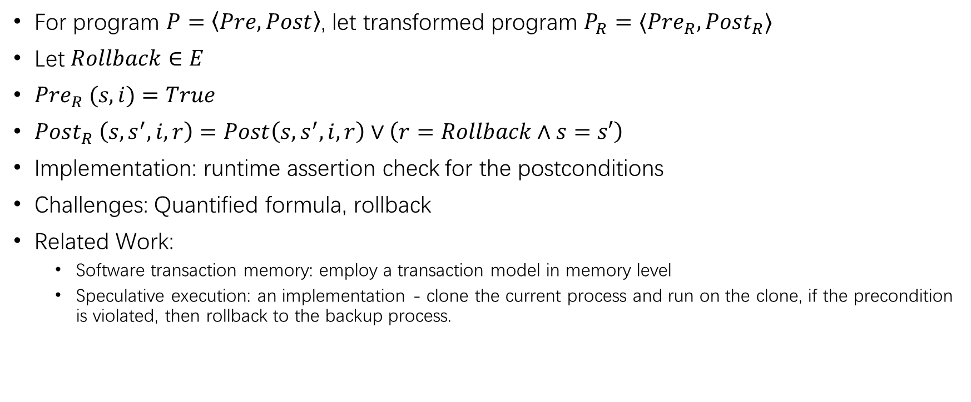
Transaction-like
For program $P=\left\langle Pre,Post\right\rangle$, let transformed program $P_{R}=⟨Pre_{R},Post_{R}⟩$
Let $Rollback∈E$
$Pre_{R} (s,i)=True$
$Post_{R} \left(s,s^{′},i,r\right)=Post\left(s,s^{′},i,r\right)∨\left(r=Rollback∧s=s′\right)$
Implementation: runtime assertion check for the postconditions
Challenges: Quantified formula, rollback
Related Work:
Software transaction memory: employ a transaction model in memory level
Speculative execution: an implementation - clone the current process and run on the clone, if the precondition is violated, then rollback to the backup process.
Mannarswamy, S. (2017). Software Transactional Memory. Programming Multicore and Many-Core Computing Systems, (January 1996), 81–98. https://doi.org/10.1002/9781119332015.ch4
Nightingale, E. B., Chen, P. M., & Flinn, J. (2005). Speculative execution in a distributed file system. Proceedings of the 20th ACM Symposium on Operating Systems Principles, SOSP 2005, 191–205. https://doi.org/10.1145/1095810.1095829

Slide 8
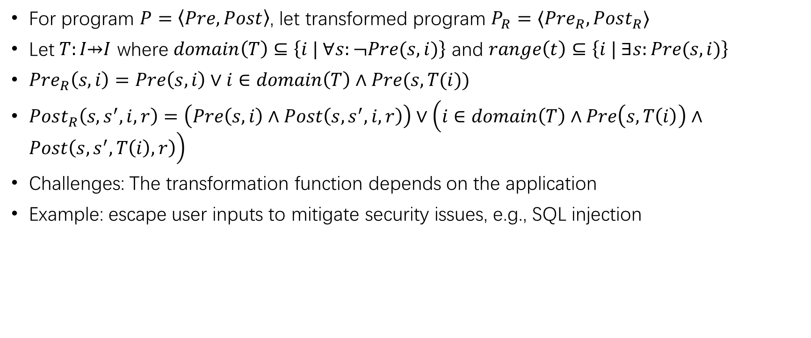
Transforming inputs to acceptable value
For program $P=\left\langle Pre,Post\right\rangle$, let transformed program $P_{R}=⟨Pre_{R},Post_{R}⟩$
Let $T:I\text{⇸}I$ where $domain\left(T\right)⊆\left\{i | ∀s:¬Pre(s,i)\right\}$ and $range\left(t\right)⊆\left\{i | ∃s:Pre(s,i)\right\}$
$Pre_{R}\left(s,i\right)=Pre\left(s,i\right)∨i∈domain\left(T\right)∧Pre(s,T(i))$
$Post_{R}\left(s,s^{′},i,r\right)=\left(Pre\left(s,i\right)∧Post\left(s,s^{′},i,r\right)\right)∨\left(i∈domain\left(T\right)∧Pre\left(s,T\left(i\right)\right)∧Post\left(s,s^{′},T\left(i\right),r\right)\right)$
Challenges: The transformation function depends on the application
Example: escape user inputs to mitigate security issues, e.g., SQL injection
Kern, C. (2014). Securing the tangled web. Communications of the ACM, 57(9), 38–47. https://doi.org/10.1145/2643134

Slide 9
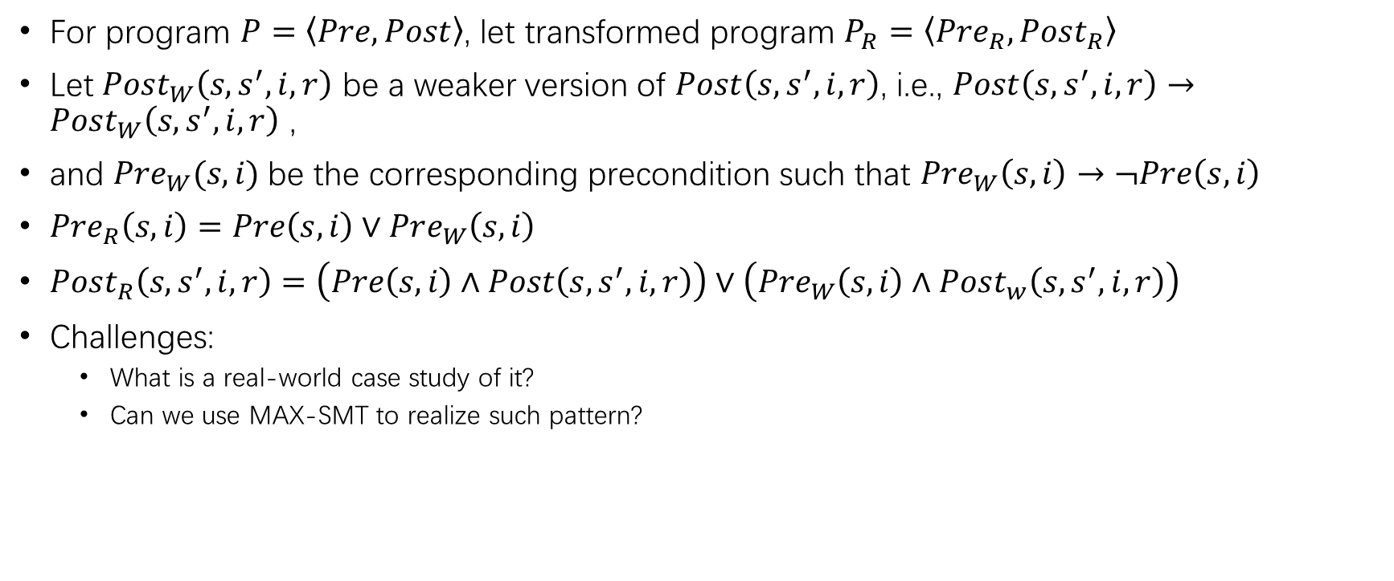
Weaken the postcondition
For program $P=\left\langle Pre,Post\right\rangle$, let transformed program $P_{R}=\left\langle Pre_{R},Post_{R}\right\rangle$
Let $Post_{W}\left(s,s^{′},i,r\right)$ be a weaker version of $Post\left(s,s^{′},i,r\right)$, i.e., $Post\left(s,s^{′},i,r\right)→Post_{W}\left(s,s^{′},i,r\right)$ ,
and $Pre_{W}(s,i)$be the corresponding precondition such that $Pre_{W}\left(s,i\right)→¬Pre\left(s,i\right)$
$Pre_{R}\left(s,i\right)=Pre\left(s,i\right)∨Pre_{W}\left(s,i\right)$
$Post_{R}\left(s,s^{′},i,r\right)=\left(Pre\left(s,i\right)∧Post\left(s,s^{′},i,r\right)\right)∨\left(Pre_{W}\left(s,i\right)∧Post_{w}\left(s,s^{′},i,r\right)\right)$
Challenges:
What is a real-world case study of it?
Can we use MAX-SMT to realize such pattern?

Slide 10
Failure oblivious computing
A conceptual framework which allows a system continue delivering acceptable service even if flawed.
More robust in the sense that a system is still providing some crucial functionalities even under faults.
Implementation:
Rinard’s work: For an array, redirect the out of bound reads to its first element; discard the out of bound writes
In general, catch those fatal errors and transform them into some safe default behaviors.
Related Topic:
Approximate computing, e.g., loop perforation which sacrifices exact program accuracy to improve performance
Rinard, M., Cadar, C., & Nguyen, H. H. (2005). Exploring the acceptability envelope. https://doi.org/10.1145/1094855.1094866
Rinard, M., Cadar, C., Dumitran, D., Roy, D. M., Leu, T., & Beebee, W. S. (2004). Enhancing server availability and security through failure-oblivious computing. OSDI 2004 - 6th Symposium on Operating Systems Design and Implementation, 303–316.

Slide 11
Mutational Robustness in Biology
Mutational robustness is the organism’s ability to maintain phenotypic traits in the face of internal genetic mutations.
Environmental robustness is its ability to maintain functionality across a wide range of environments.
Mutational robustness contributes to environmental robustness.
Also, it contributes to a population’s ability to evolve.
Reference: https://en.wikipedia.org/wiki/Robustness_(evolution)

Slide 12
Mutational Robustness in Software
The fraction of random mutations to program code that leave a program’s behavior unchanged.
Schulte’s work uses genetic programming to randomly generate a population of programs and shows that mutational robustness exists in a variety of programs.
They argue that:
Neutral mutants may imply undetected bugs
It can help build automatic n-version programming
E. Schulte, Z. P. Fry, E. Fast, W. Weimer, and S. Forrest, “Software mutational robustness,” Genet. Program. Evolvable Mach., vol. 15, no. 3, pp. 281–312, 2014.

Slide 13
Mutational Robustness in Software
Can we build the connection between mutational robustness and environmental robustness in software?
Can genetic programming help improve the robustness?

